Slide 1
Financial Resources
(The Budgeting Process & Financial Management)
NUT 468

Slide 2
Financial Resources
Budgeting (Budgets, Process, Types, …)
Definition
Purpose of Budgeting
Types of Budgets
Operating Budgets
Capital Budgets
Financial Reports
Operating Statement
Profit & Loss Statement
Balance Sheet

Slide 3
A-Budgeting Process

Slide 4
What is a budget???
Why do we create budgets???
A budget is the organization’s business plan expressed in financial terms. It should be based on the mission, goals, and objectives of the organization

Slide 5
Purpose of Creating a Budget
Budget helps set parameters for activities to be done during the budget period
Gives managers guidance about what financial resources are available to carry out their work
Allows managers to plan and think ahead about certainties and risks associated with their decisions
Budgets also act as a control device for regulating spending in an organization

Slide 6
Purpose of Creating a Budget
Budgets provide an objective set of criteria
Budgeting is synonymous with forecast, which involves “forecasting” (predicting) what expenses, revenues, … can be

Slide 7
Types of Budgets
Operating Budget
Capital Budget
Cash Budget
Budgeted Balance Sheet
Master Budget

Slide 8
Important to NOTE!
The difference between a fiscal year and a calendar year:
A calendar year begins on January 1, XXXX and ends on December 31, XXXX
A fiscal year can begin on any date and end 365 days later

Slide 9
Cost Center VS. Revenue Center
Cost Center
Not expected to generate profit of break even
Revenue Center
Any department that can generate some income
Examples include payroll, human resources, material management
Examples include clinical nutrition service and foodservice

Slide 10
Cost Center VS. Revenue Center
Once income exceeds cost by a substantial amount, the revenue center is also considered a profit center
Notes:
Clinical nutrition services DO NOT usually operate as profit centers, because their revenues seldom exceed the cost of providing services
Foodservices normally DO & EARN a profit

Slide 11
Reporting Periods
Some organizations use a calendar month as an accounting period (that is twelve reporting periods in a year)
Other organizations use four weeks blocks that start on Sundays and end on Saturdays (that is thirteen reporting periods a year)
Notes:
1 month vs. 4 weeks (52/4)

Slide 12
I-Operating Budget
Operating budgets are those budgets that:
Project the income of the organization
Allocate the funds for the accomplishment of work
They can be prepared for:
Entire organization (Ex: Operating Budget of Rizk Hospital)
Separate departments (Ex: Dietetic Unit at Rizk Hospital, Cardiology Unit, etc…)
Notes:
It should be included because every dollar spent should have on the other side a revenue generated. By setting first a revenue budget and below it a cost budget the reader of the operating budget ( Revenue budget - Expense budget) will see if there will be a deficit or not. If there is a deficit it means that funds need to be allocated in another way or more revenue must be generated to close the gap.

Slide 13
I-Operating Budget
Operating budgets are normally prepared and planned for a whole year
They do not carry over from year to year (ex: if the manager at Rizk Hospital saves money this year they can not carry it and spend it next year)
When preparing an operating budget it is in the best interest of every manager to be as ACCURATE as possible

Slide 14
I-Operating Budget- Types
Operating budgets are of TWO types:
Incremental
Fixed
Variable
Zero Based
Fixed
Variable

Slide 15
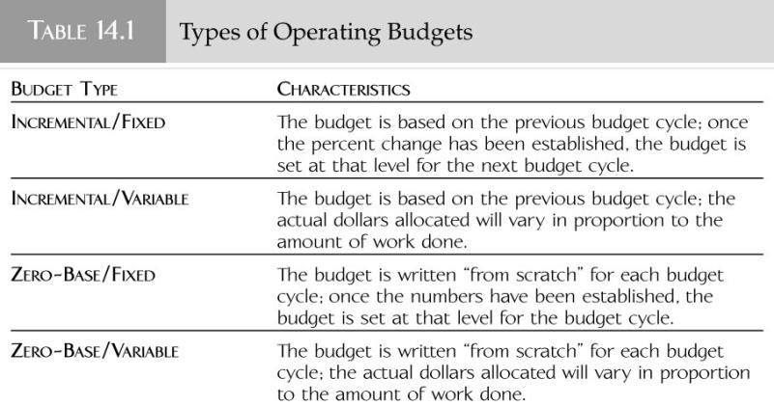
I-Operating Budget- Types

Slide 16
I-Operating Budget- Preparation
The typical procedure to prepare an operating budget includes:
Project revenues (volume of work to be done, price of the product, anticipated price increase, …)
Estimate labor needs and costs
Estimate non-labor expenses
Combine parts of the budget to project profit or loss

Slide 17
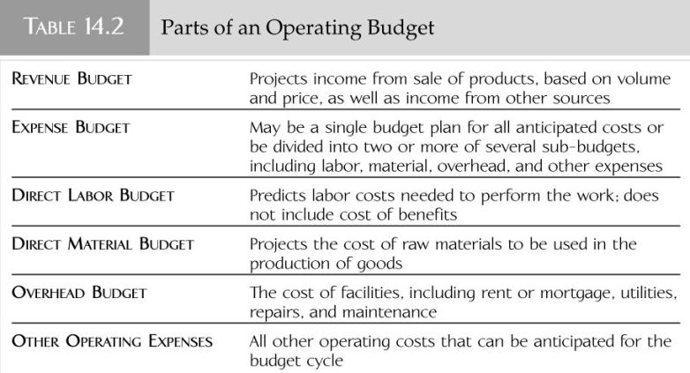
I-Operating Budget- Preparation
A
B
C
D
E
F
A: Revenue budget makes up the Revenue part of the Operating Budget ONLY.
B, C, D, E, F: All these sections make up the Expenses part of the Operating Budget

Slide 18
Revenues A: Revenue Budget
The projection of the income of an organization or a department based on the sale of products (part of operating budget)
Prepared only for revenue centers, not prepared for departments that are solely cost centers
Thing to take into consideration:
Prices and sales volume
Money from non-sales sources
Bad debts
Notes:
i.e. renting the clinic for other purposes or to someone else, dietitians giving presentations etc…

Slide 19
Expenses B: Expense Budget
Component of the operating budget that deals with all anticipated costs, which can be further divided into a number of sub-budgets

Slide 20
Expenses C: Direct Labor Budget
Labor costs that are related to the actual performance of work.
Example
Base pay
Overtime
Pay in lieu of benefits
These are the projections that get written into the labor budget

Slide 21
Expenses D: Direct Material Budget
The estimate of cost for raw materials to be used in the production of goods
This part of the operating budget is computed for departments that produce a tangible product

Slide 22
Expenses E: Overhead Budget
General expenses associated with the operation of a facility such as:
Rent
Taxes
Utilities
Repairs
Maintenance

Slide 23
Expenses F: Other Operating Expenses
Part of the operating budget that encompasses all other anticipated costs of operation such as:
Telephone bills
Copying charges
Printing
Office supplies
Books
Travel
Journals
Postage
Fees
Licenses

Slide 24
Expenses F: Other Operating Expenses
This category basically covers everything else a department plans to spend for operations
Notes:
Organizations that do not use sub-budgets would also include the costs of labor, overhead, and material under this heading

Slide 25
II-Capital Budget
Other part of the master budget
Investments in things like land, buildings, major pieces of equipment are all considered CAPITAL expenditures
Examples of such items include:
Ovens
Dishwashers
Computer systems
Heavy machinery
Food processing plant
MRI machines
Radiology equipment

Slide 26
II-Capital Budget
These items are expected to last for a long time
Several organizations set a dollar value for capital goods
Usually there is an organization-wide system for allocation of funds
Managers write proposals to request funds
Notes:
Managers are not allocated funds

Slide 27
II-Capital Budget- Preparation
The preparation of the capital budget is a FIVE step process
Determine capital goods needed
Prioritize items
Most time/energy spent justifying most-needed items
Estimate costs
Cost is likely to change between time of budget preparation and time of funding
Probably too early to choose specific product

Slide 28
II-Capital Budget- Preparation
Write budget request using organization-specific format
Justification usually most crucial part of document
Submit paperwork on time and in correct form

Slide 29
II-Capital Budget- Preparation

Slide 30
B-Financial Reports
Operating Statement/performance report
Profit & Loss Statement (P&L)
Balance Sheet

Slide 31
Operating Statement
Also known as a performance report
Compares fiscal /actual performance to the budget
Information on the operating statement includes:
Budget for the accounting period
Amount budgeted from the beginning of the fiscal year
Should be generated promptly so that results can be used to make adjustments
Example: increased membership revenues for health club = more customers, more staff needed to maintain level of service

Slide 32
Operating Statement
Prepared by the accounting department in an organization
These are internal departmental tools used by managers
Explanation required if variance is 5% or more

Slide 33
Profit & Loss Statement (P&L)
P&L statement generally prepared by accounting department
P&L normally prepared for the entire organization
Generally used as tools for upper management
Document used as a tool to report on organization’s financial performance to:
Employees
Bankers
Stockholders
Investors

Slide 34
Profit & Loss Statement (P&L)
The document lists the following:
Controllable as well as uncontrollable revenues
Controllable as well as uncontrollable expenses
Net profits or losses
Generated as a year to date document or on an annual basis
Document produced for an entire organization and not a department on its own

Slide 35
Profit & Loss Statement (P&L)
P&L lists all revenues and expenses however these values are NOT compared with the budgeted amounts

Slide 36
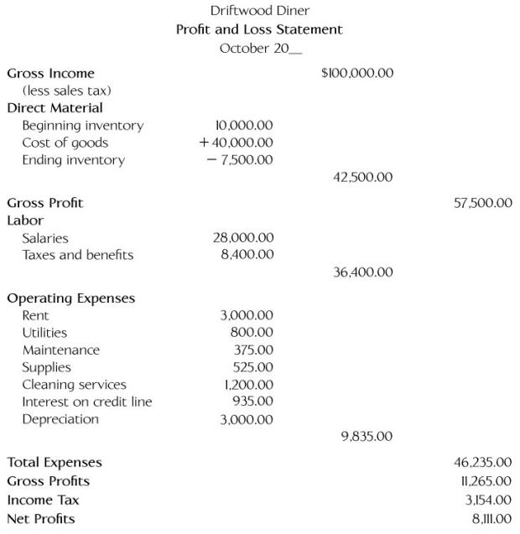
Notes:
a. Gross Income - Direct material= 100,000 - 42,500 = 57,500 (gross profit)
b. Labor +Operating expense = 36,400 +9,835 = 46,235 (total expense)
c. Earnings before taxes = Gross profit - total expenses = 57,500 - 46, 235 = 11,265
d. Net Income = Earning before taxes (the second gross profit as per the slide) - Taxes = 11,265 -3,154= 8,111

Slide 37
Balance Sheet
A financial report that summarizes an organization’s:
Assets
Liabilities
Equity
It provides the user with a snapshot of the organization’s financial status at a specific point in time

Slide 38
Balance Sheet
What is an ASSET ?
An asset is a FUTURE BENEFIT obtained or controlled by an entity as a result of a past transaction
What is a LIABILITY ?
A liability is a FUTURE SACRIFICE of benefits arising from present obligations of an entity to transfer assets or provide services as a result of a past transaction or event
What is EQUITY ?
Equity is the difference between TOTAL ASSETS and TOTAL LIABILITIES
Notes:
Asset : You bought a car by paying a cash amount from your own pocket of $20,000. The car is the asset
a. The transaction made is $20,000 cash.
b.The future benefit is the ownership and the use of the car.
Liability: You bought a car by taking a loan amount of $20,000. The $ 20,000 is a liability
a.The $20,000 is a future sacrifice since you need to repay it.
b. Benefit is the ownership and the use of the car

Slide 39
Balance Sheet
Balance sheets are used for:
Obtaining loans
Participating in mergers
Legal matters
Basic format of this tool is listing all of the assets and liabilities of an organization
This report is prepared by the accounting department

